Slide 1
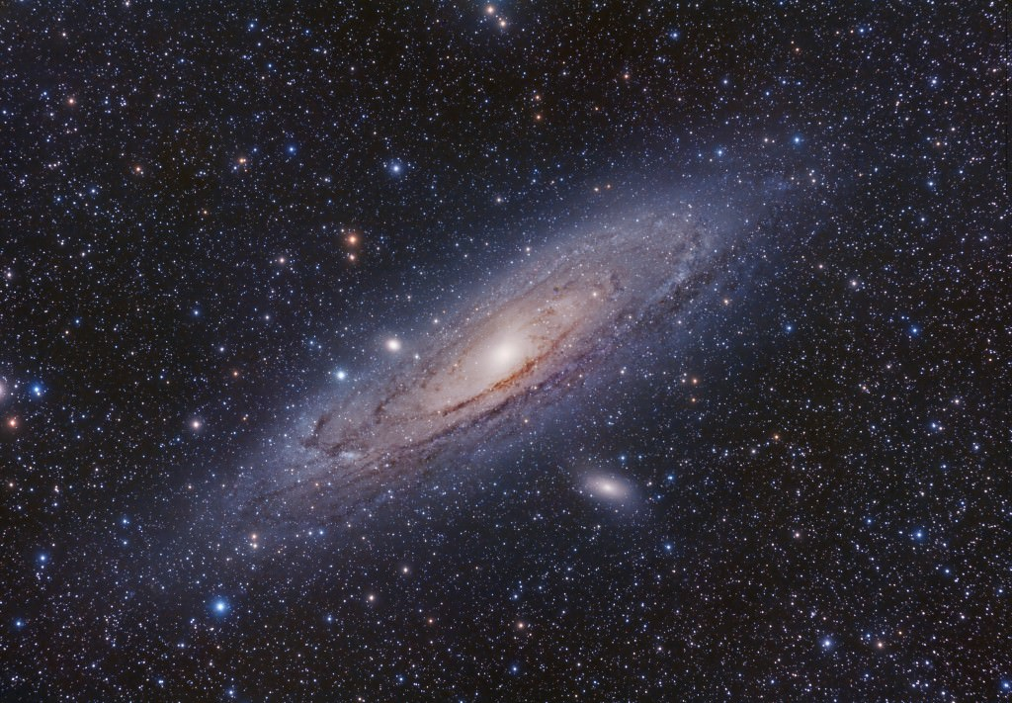



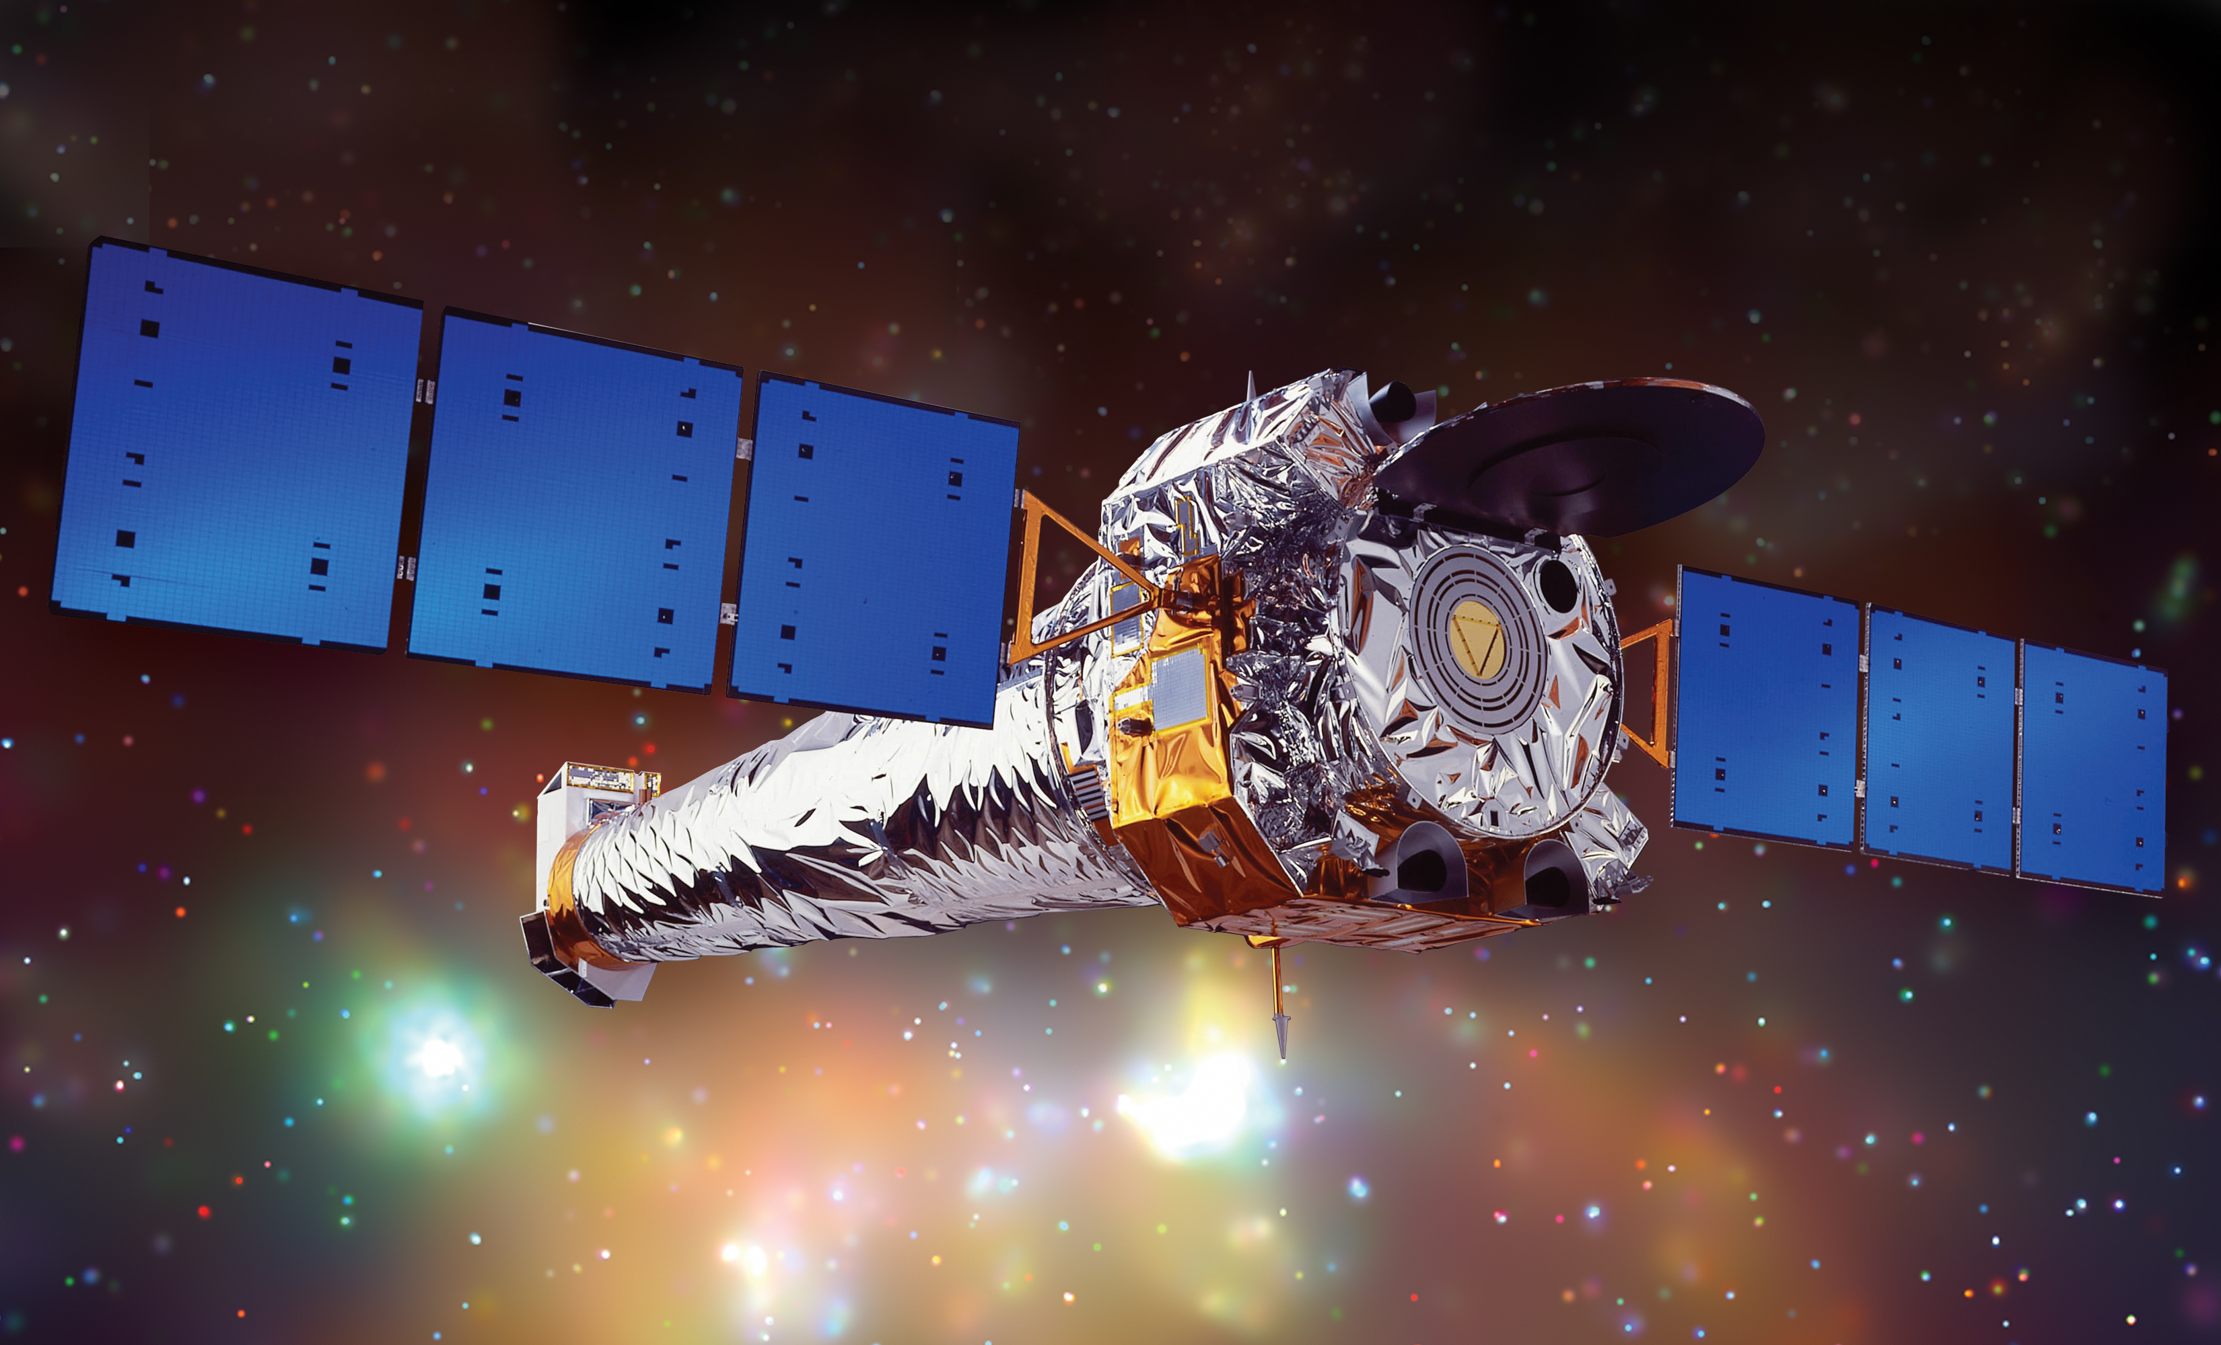
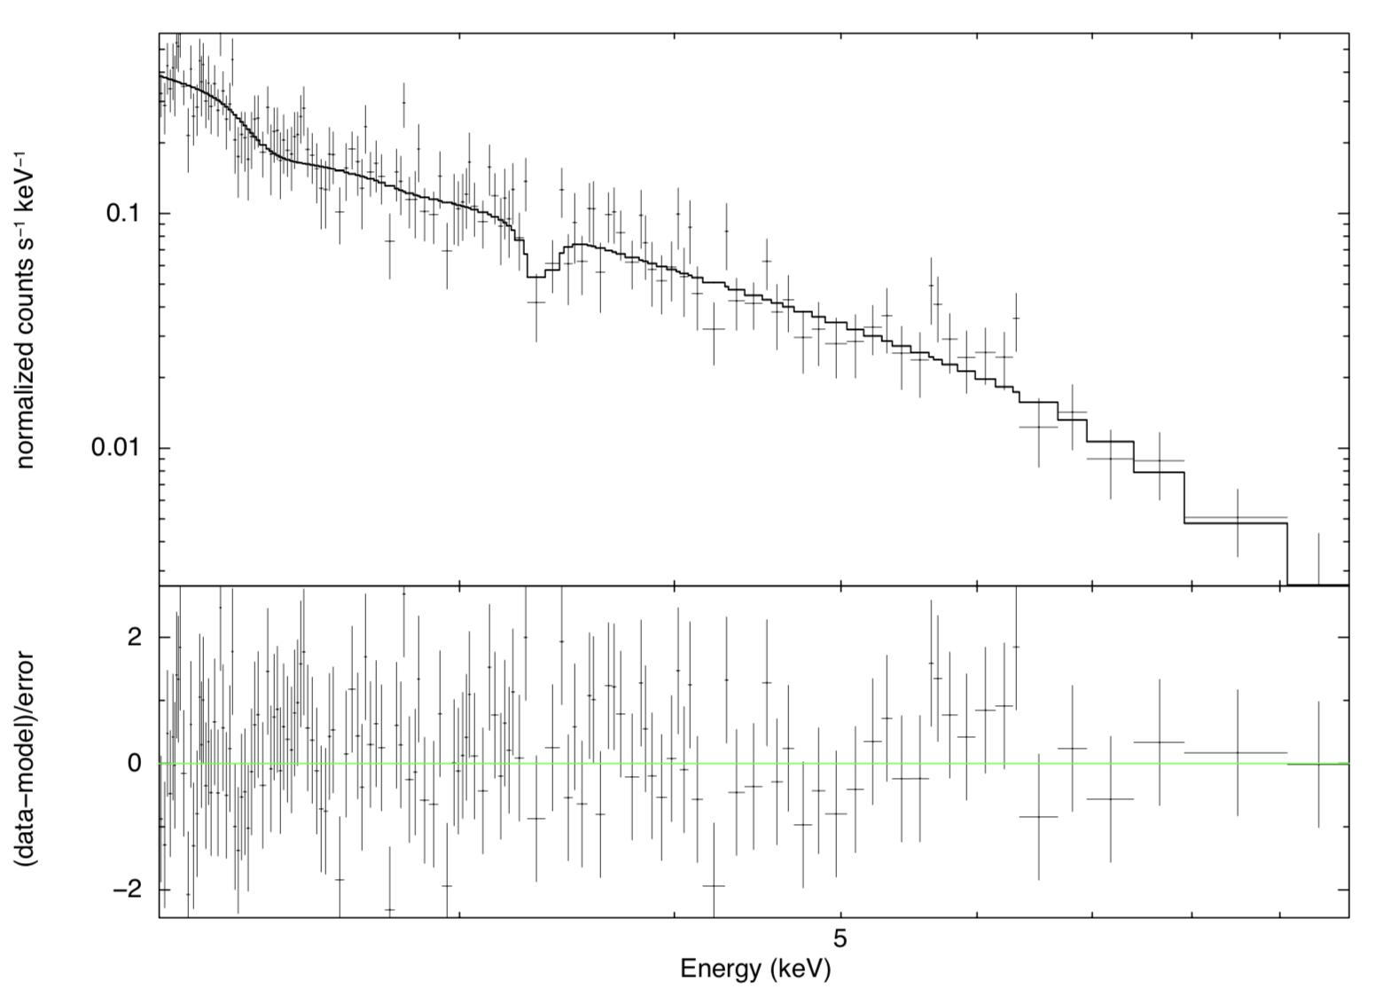
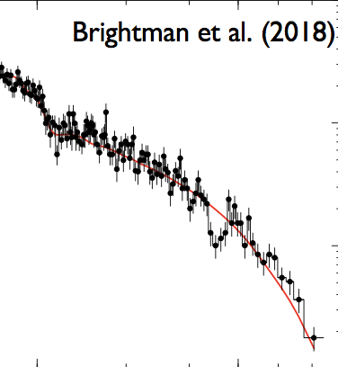
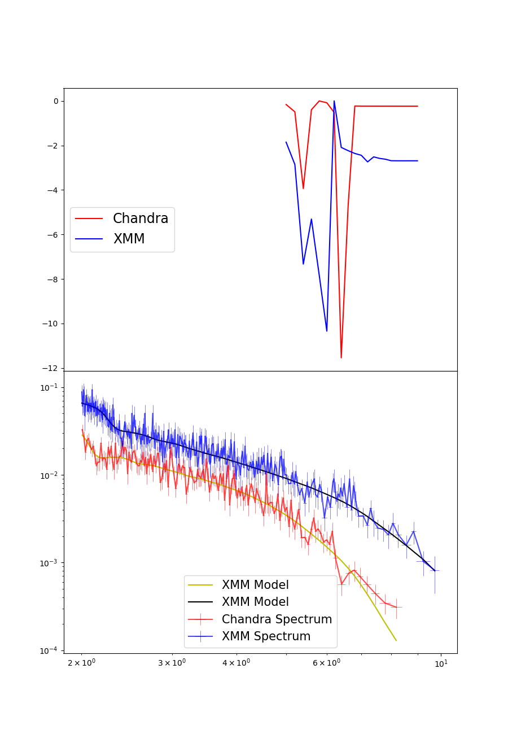


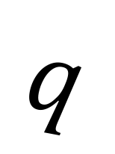









A systematic search for absorption features in the X-ray spectra of ultraluminous X-ray sources
A. Sosanya, M. Brightman, F.A Harrison, H.P Earnshaw, K. Madsen, M. Heida, D.J Walton
Neutron Star-Powered X-Ray Sources
Ultraluminous X-ray sources (ULXs) are variable, non-nuclear bright X-ray sources in nearby galaxies not associated with the central supermassive black hole. These ULXs are brighter than black hole systems in our galaxy—they have super-Eddington luminosities greater than stellar mass black holes. These ULXs break the Eddington theory because there are extreme accretion rates onto a compact stellar remnant, or an intermediate mass black hole. It was previously thought that only black hole accretion could power ULXs, but the discovery of pulsations has shown that neutron stars may also power ULXs. Using the data from the XMM-Newton and Chandra X-ray observatories, we conducted a systematic search to find cyclotron resonance scattering features in the X-ray spectra of ULXs to identify neutron-star powered ULXs. The results may findings provide further insight into the analysis techniques for future neutron star-powered ULXs and estimation of their magnetic field strengths.
XMM-Newton (left),
and Chandra Observatory
(right)
Analysis & Results
The systematic search found three strong candidates for analysis: Holmberg II X-1, IC 342, and M32.
Holmberg II X-1
Unidentified feature found in Holmberg II at $E\sim 3.35$ keV, yet $χ^{2}=6$
Eddington Luminosity
Although IC-342 showed statistical promise with $χ^{2}=8$, there were no features detected within the continuum.
The Eddington Luminosity is the maximum luminosity a star attains when radiation pressure from the star and gravitation pressure are balanced.
$\frac{dP}{dr}=\frac{kp}{c}F_{rad}$ = $\frac{GMp}{r^{2}}$, where $F=\frac{L}{4πr^{2}}$
$${ L}_{ed}=\frac{4πGc}{k}M$$
$${ G}_{NS}$$
$$F_{rad}$$
NS
(Above) XMM observation 0112520701 of Holmberg II, shjowing absorption feature at 3.3 keV
CRSFs
$$E_{3}$$
IC-342
The energy transitions between Landau levels cause CRSFs and are present in spectra. They allow for the Cyclotron lines imply the presence of a magnetized neutron star and give a measurement of its field strength.
$$q$$
$$E_{1}$$
$$E_{2}$$
$$B_{cyc}$$
$$E=0$$
(Above)
A 2-D representation of Landau levels
M32
The ULXs observed in M32 are proximate to each other, and therefore needed Chandra data for spatial resolution
(Right) Cyclotron line found in M51’s ULX-8 found by M.Brightman, now believed to be neutron-star powered.
Absorption lines found in two different observations
$E\sim 6$ keV detected at $3σ level$in XMM observation with $χ^{2}=8$
$E\sim 6.5$keV detected at $2σ$ level in Chandra observation with $χ^{2}=12$
Methods
Systematic Search
Cross-referenced the Serendipitous XMM-Survey to find ULXs with at least 10,000 intensity counts.
Spectral Analysis
Reduced XMM and Chandra data and found favorable spectral extraction parameters using Chi Squared test.
Used spectral fitting software XSPEC to analyze detector data and fitted the spectra with a coupled cutoff power law continuum and Gaussian absorption (zgauss)
Ran simulations to assess false alarm rate from statistical fluctuations.
Conclusion & Future Work
Different energies between XMM’s and Chandra’s M32 observation may be due to change in orientation of magnetic field between observations, possibility of an Iron K-edge, or a detector deficiency. High confidence statistic implies fluctuations are unlikely.
Future observations needed to gather more data on M32 and Holmberg II.
Need to compare spectral data from different detectors
Acknowledgements
Caltech WAVE Fellows Program
SoCal Edison
References
M. Brightman et al. 2018
H.P. Earnshaw et al. 2018
M. Bachetti et al. 2014
D.J Walton et al. 2016

